Slide 1
MRI Induction 2023
30.10.2023 Robin Walker, Carl Hodgetts, Ari Lingeswaran, Ayan Sengupta

Slide 2
Outline
CUBIC as an Organization
MRI Research Culture
MRI scanner and Equipment
MRI sequences
Become an AP
Setup a study
Pilot study
Data Analysis

Slide 3
CUBIC as an Organization

Slide 4
CUBIC as an Organization
Partner Institutions:
Royal Holloway, University of London
University of Surrey
Brunel University, London
University of Roehampton, London
RHUL colleagues only scans on Tuesdays and Thursdays
Evenings and weekends possible (AP not provided)
We can also borrow time from partners if needed
Needs to be paid back – can lead to bottlenecks
Current Scanner usage stats:
Usage greatest in Terms 1 and 2, low from April - October
4

Slide 5
CUBIC RHUL Team
Director of MRI: Prof. Robin Walker
Deputy Director of MRI: Dr. Jonas Larsson
Head of MRI Research Culture: Dr. Carl Hodgetts
MRI Operations Officer: Ari Lingeswaran (Ari.Lingeswaran@rhul.ac.uk)
All aspects of running CUBIC including:
Safety Officer
Training new users (Authorised Persons APs)
Arranging first aid course
Acting as an AP (normal working hours)
Maintenance, QA etc
MRI Fellow: Dr. Ayan Sengupta (Ayan.Sengupta@rhul.ac.uk)
Supporting users in design, conduct and analysis of MRI studies
Methods innovations and good practice
Enhancing protocols, methods innovations, workshops, etc
5

Slide 6
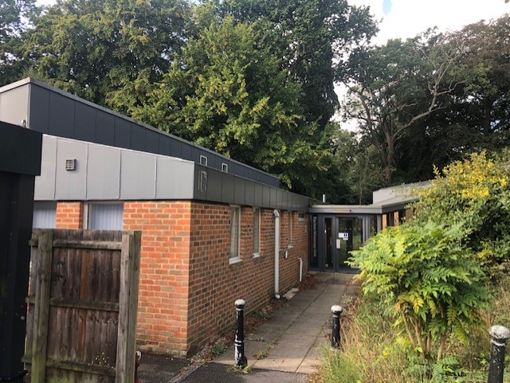
MRI Scanner Upgrade
Scanner Upgradation to Siemens CimaX or Phillips MR7700
Installation expected to start in mid-2024 and completed by Dec-2024
Current MRI scanner to remain operational throughout 2024, could be longer for a funded project
6

Slide 7
MRI Research Culture
Monthly users group meetings organized by Dr. Carl Hodgetts
Work in Progress (WIP) meetings for new studies
Involvement of partner organizations in CUBIC meetings, collaborations in research.
CUBIC Wiki (link) and forms for new studies etc.
Setting common participant pool for CUBIC in the future
7

Slide 8
MRI Scanner and Equipment
Notes:
Ari’s section starts here.

Slide 9
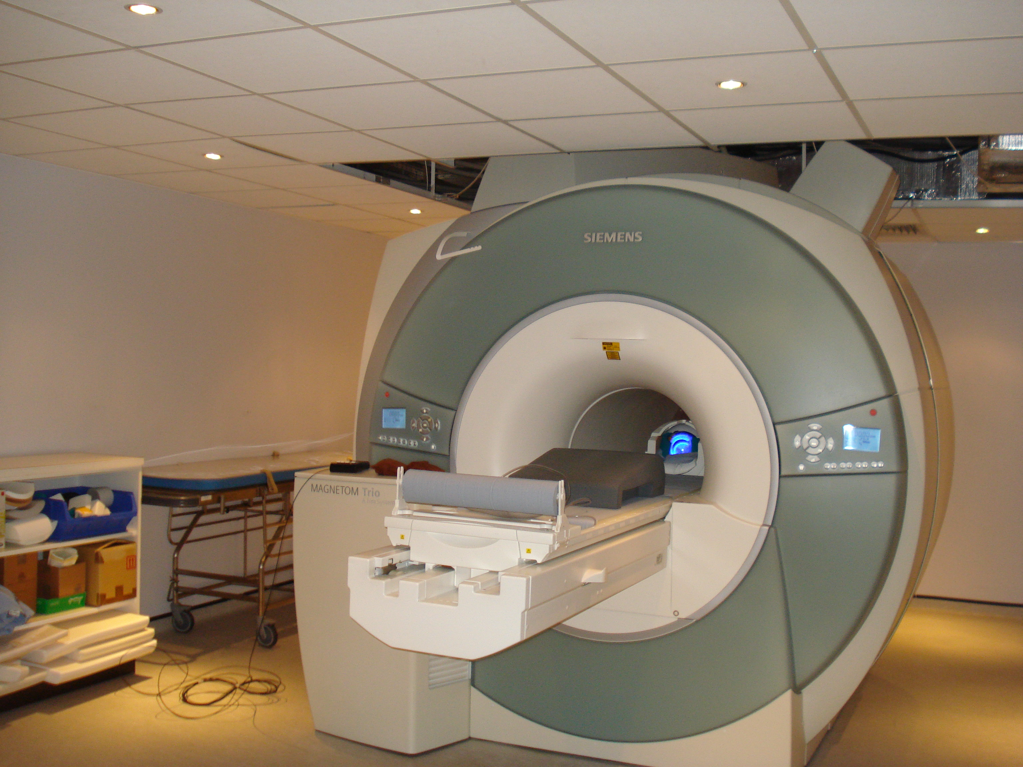
MRI Scanner and Equipment
The scanner – Siemens Trio – A TIM system
9

Slide 10
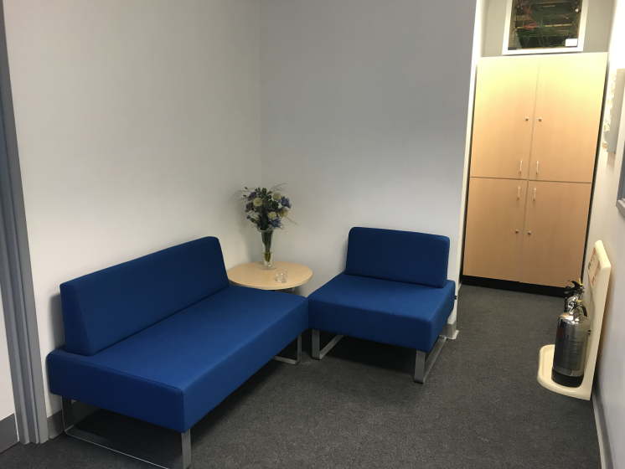
MRI Scanner and Equipment
MRI Unit - Reception Area
10

Slide 11
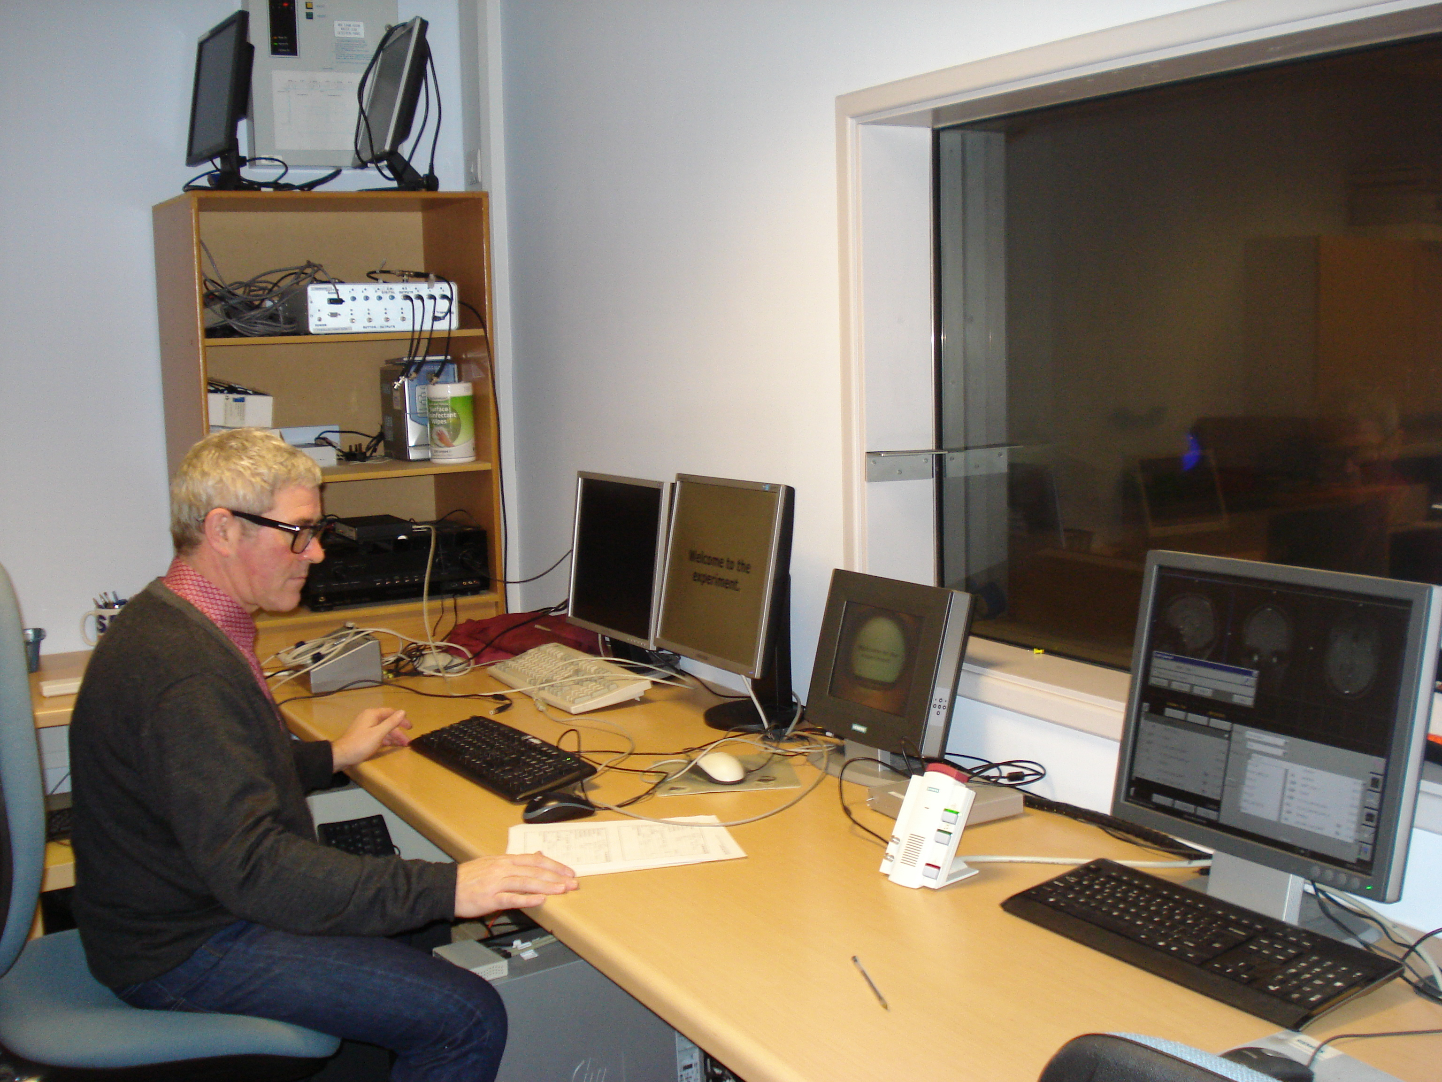
MRI Scanner and Equipment
Control Room
11

Slide 12
MRI Scanner and Equipment
Requirements for a scan:
Two APs (Authorised Persons) present.
Participants complete two screening forms and a consent form.
All screening questions answered satisfactorily.
Provides the details of their UK based GP.
Remove all metal objects, credit cards, mobile phones, etc.
12

Slide 13
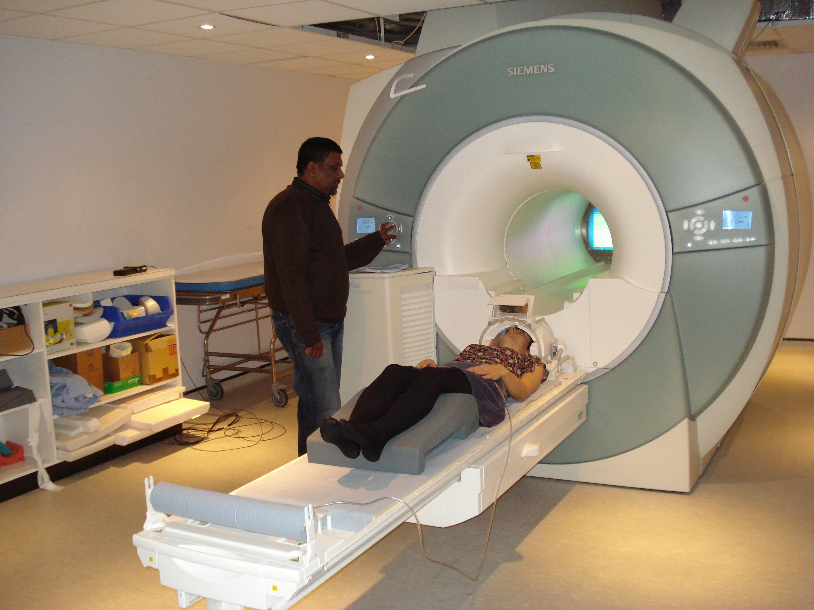
MRI Scanner and Equipment
Setting up a participant
Inform about the two-way intercom
Inform about the alarm ball
Inform about the scans &
the importance of keeping still
Participants are given either ear plugs
or headphones
supported with some padding
within the head coil
13

Slide 14
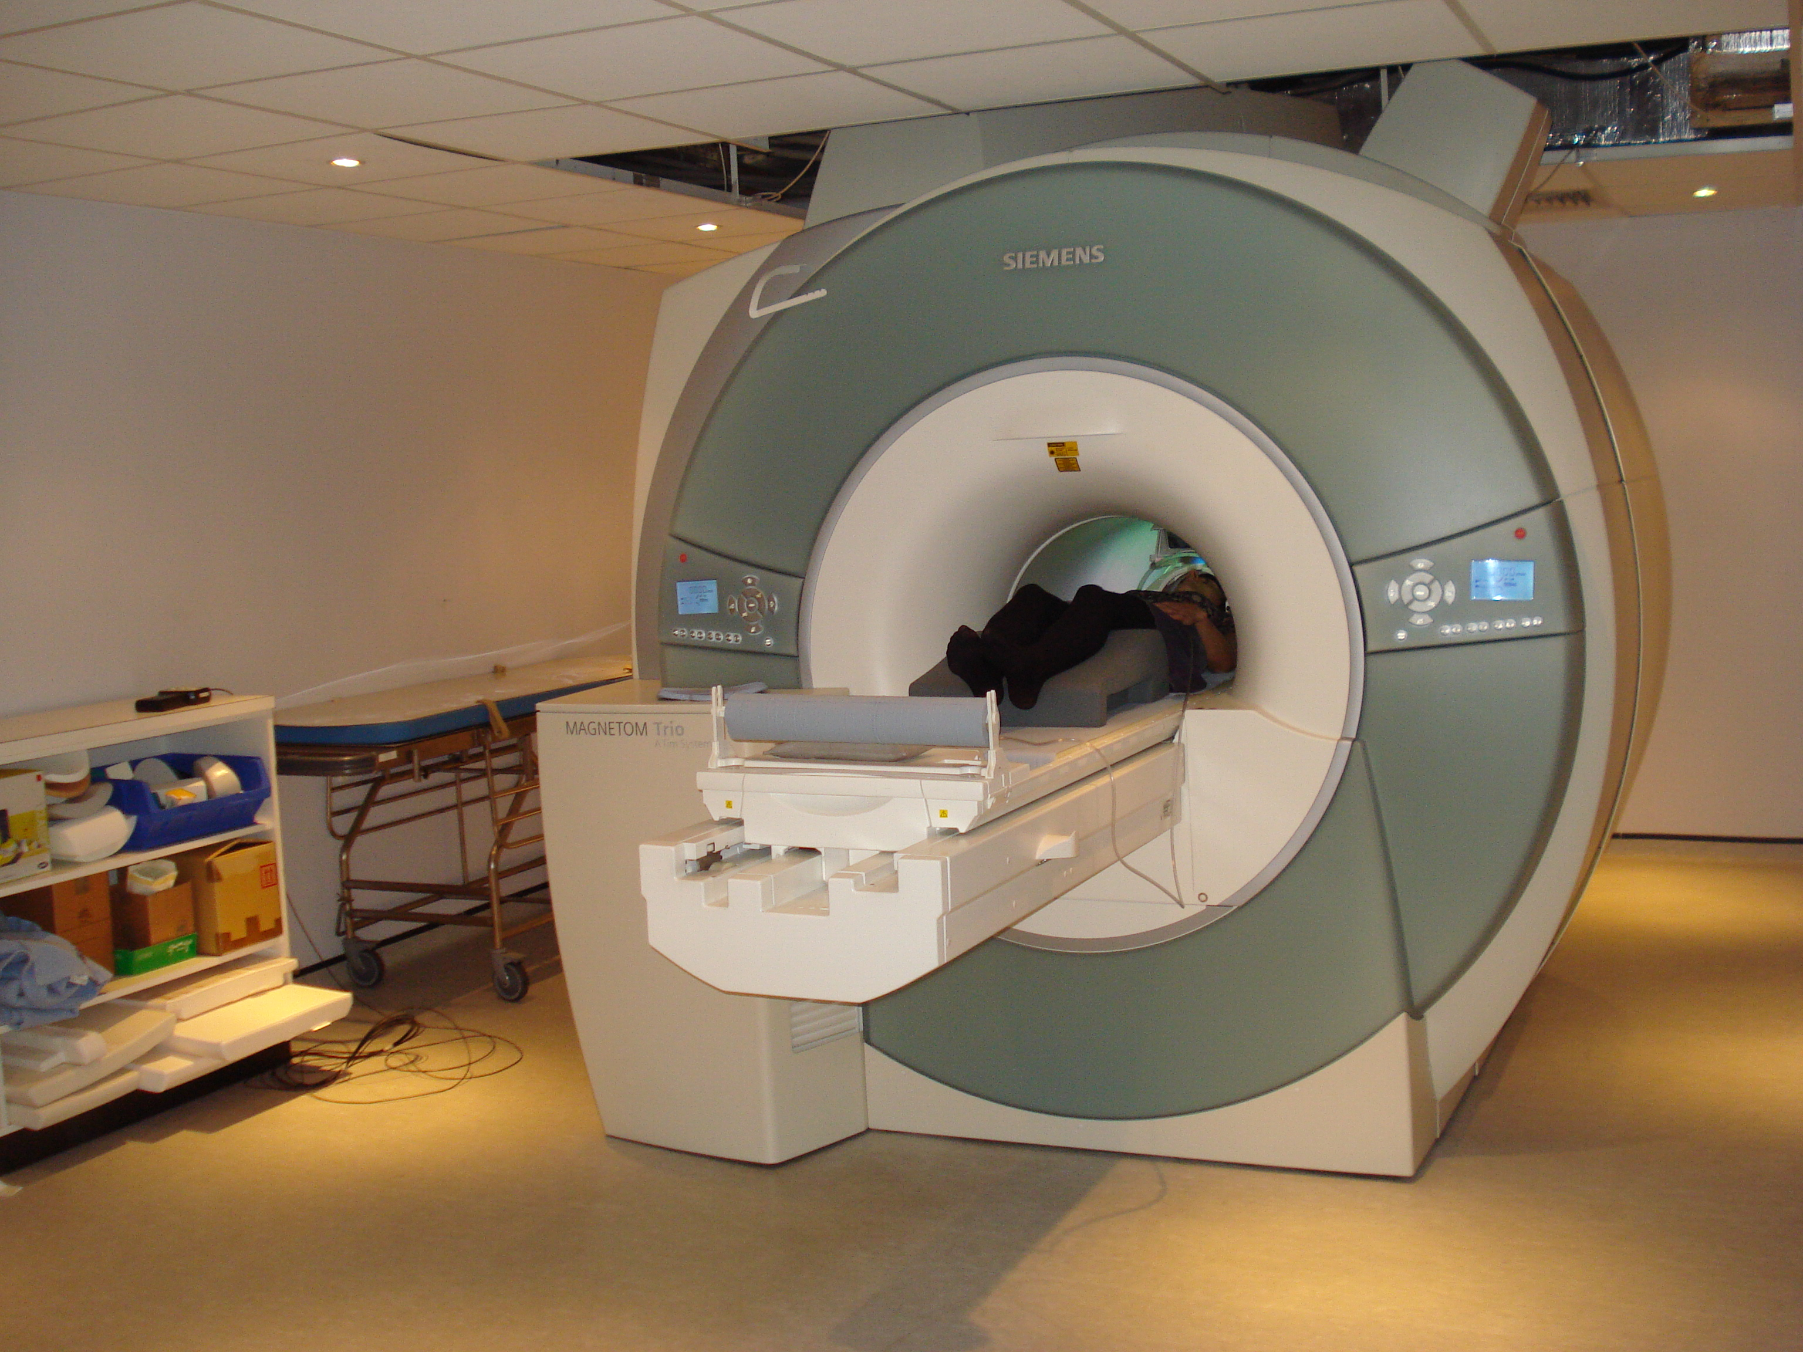
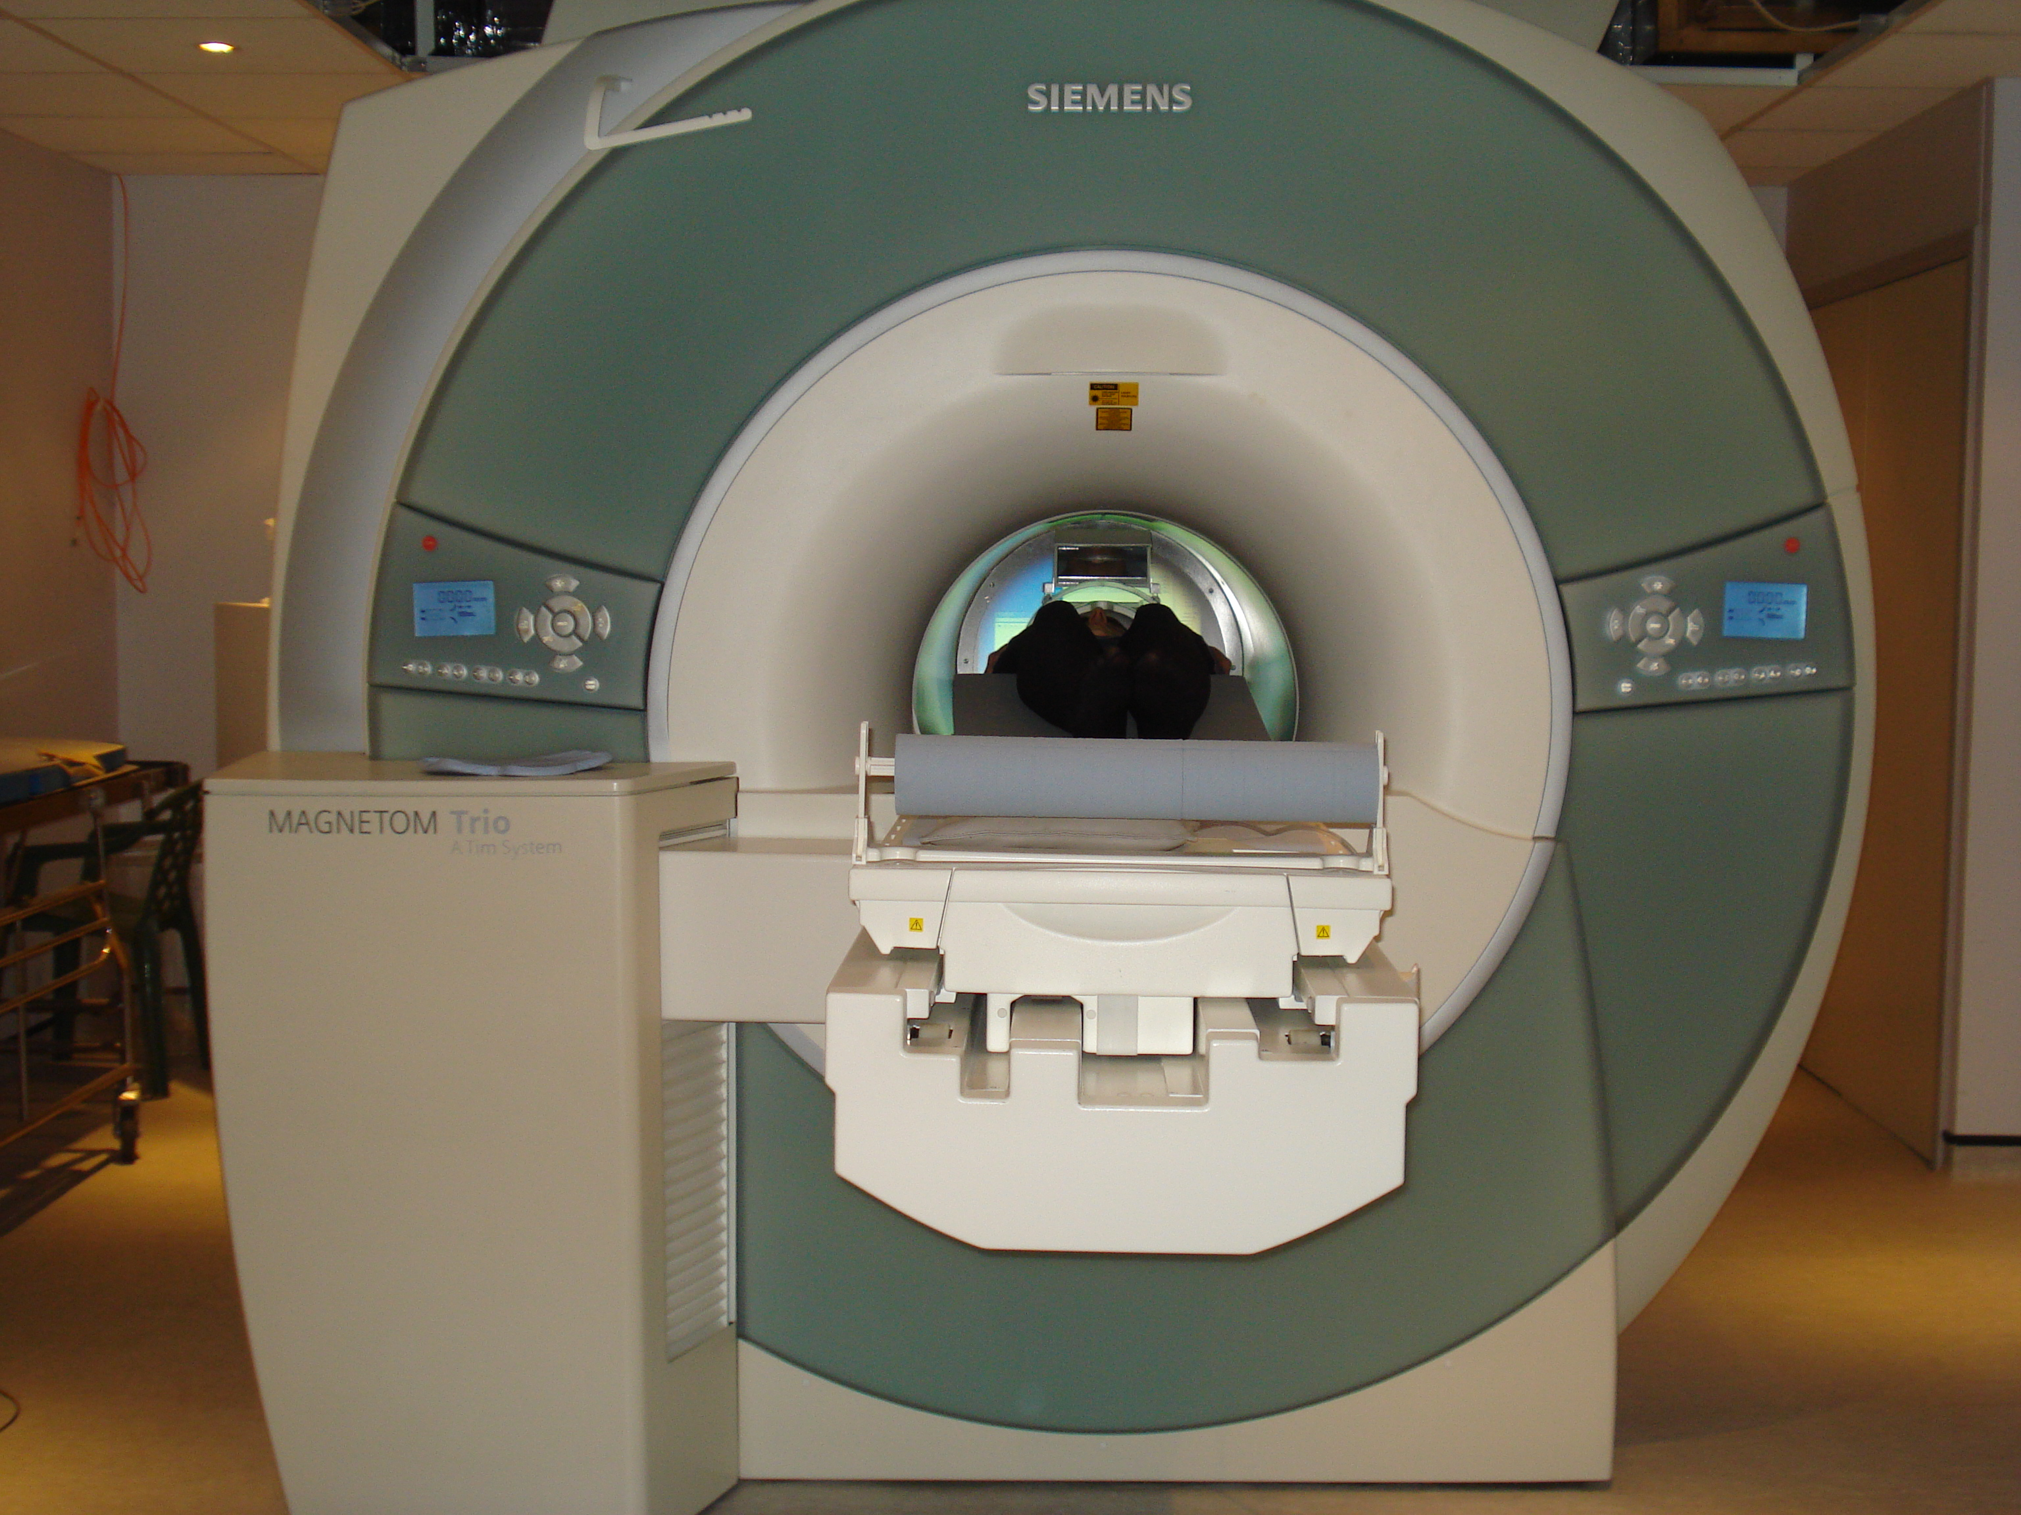
MRI Scanner and Equipment
Setting up a participant​
14

Slide 15
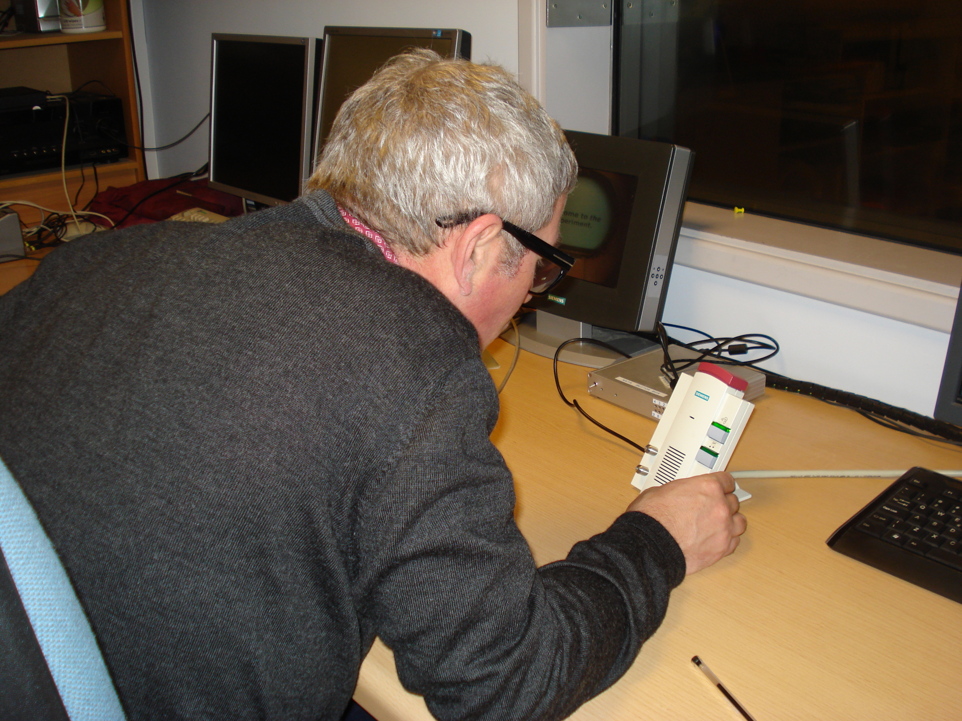
MRI Scanner and Equipment
Setting up a participant​
Using the two-way intercom
15

Slide 16
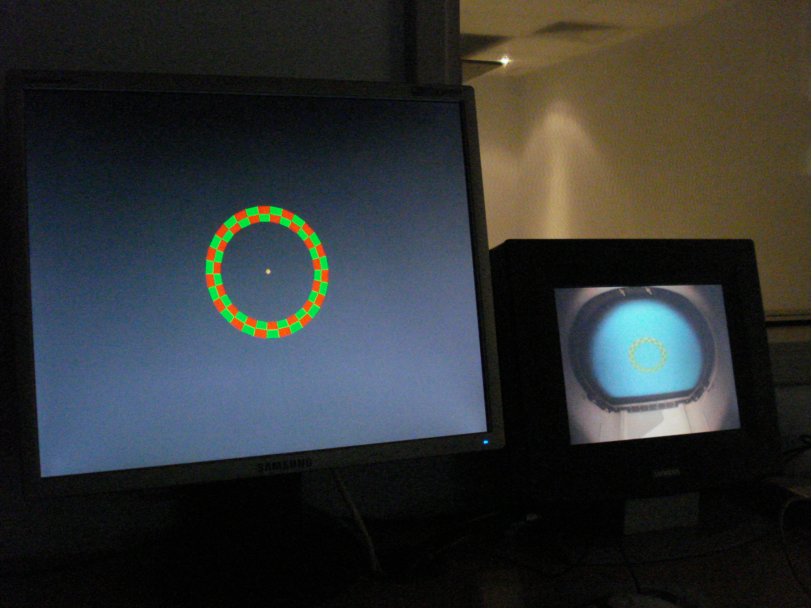
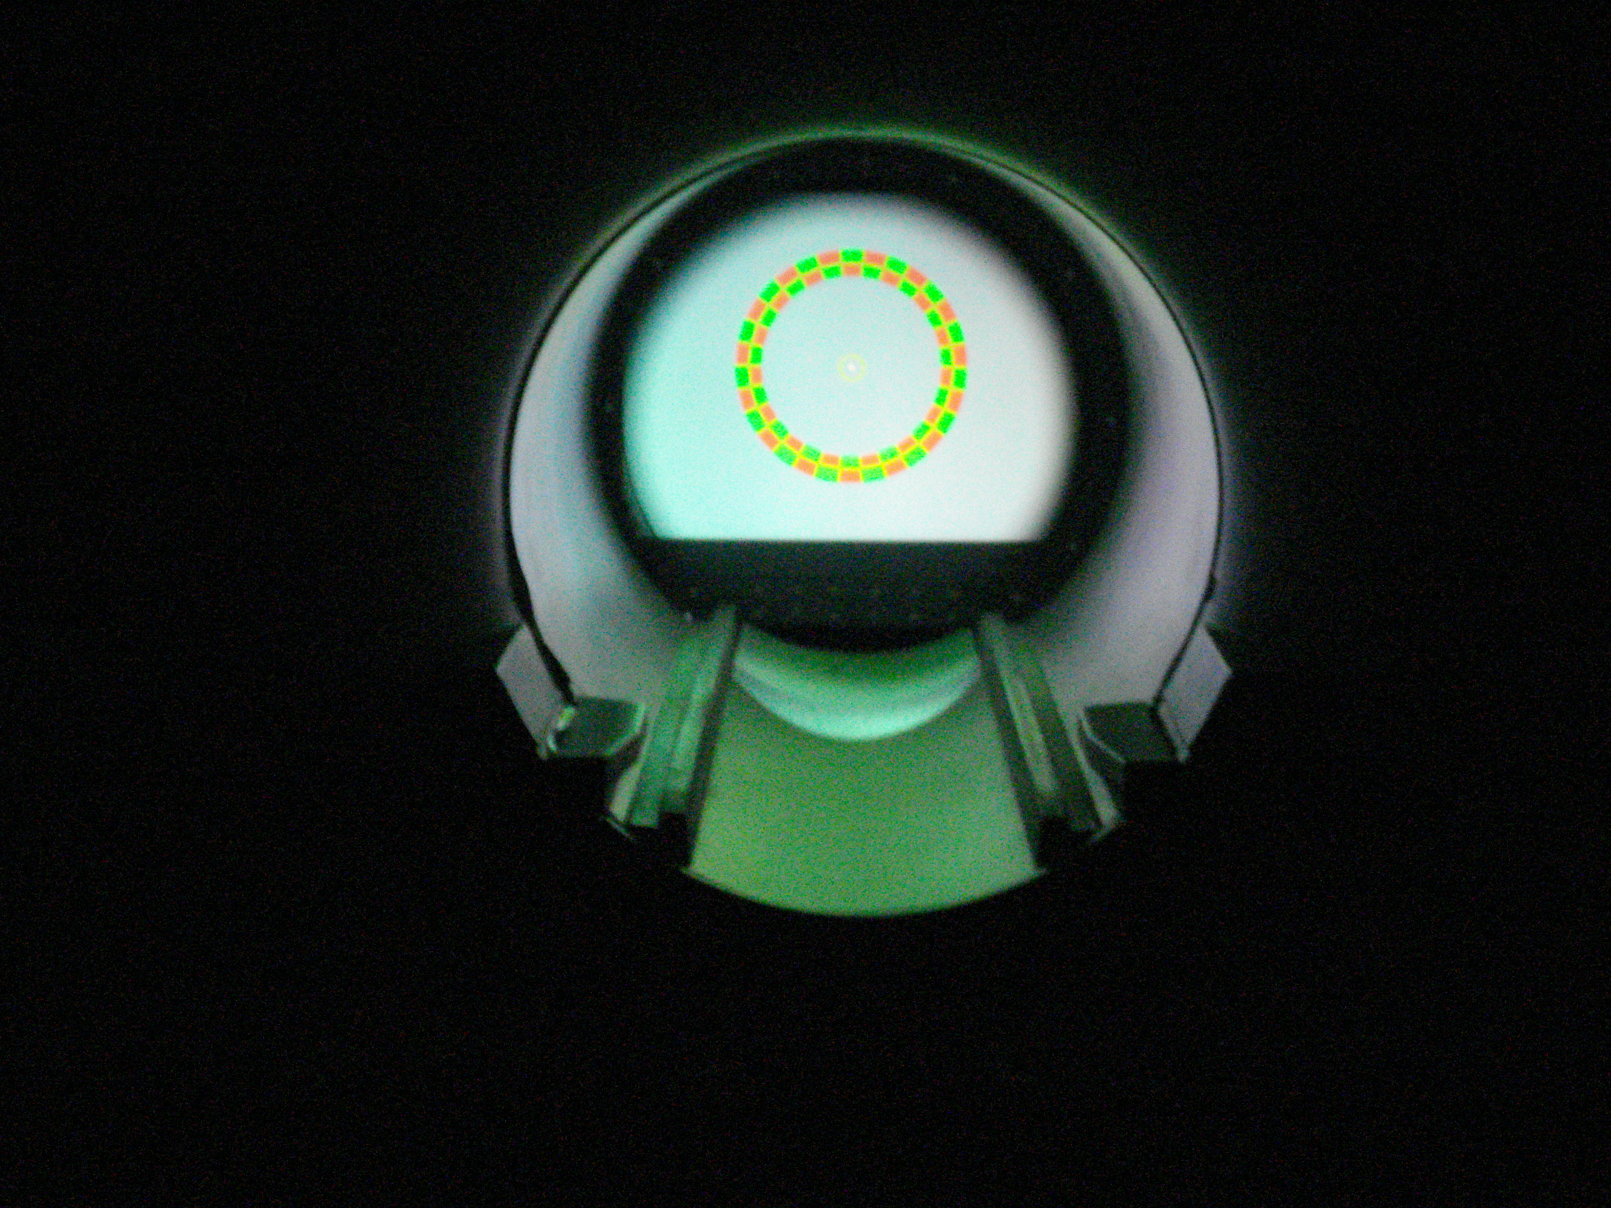
MRI Scanner and Equipment
Setting up the stimulus
Stimulus PC is available.
You can use your own laptops too.
16

Slide 17
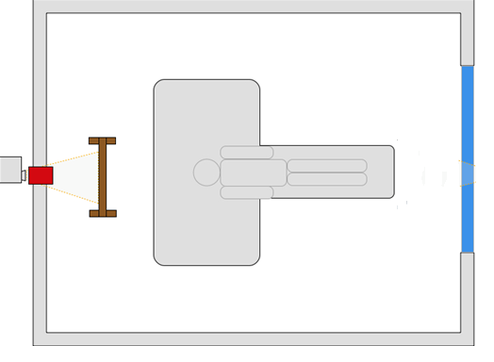
MRI Scanner and Equipment
Setting up the stimulus
Back projection technique – NEC projector
17

Slide 18
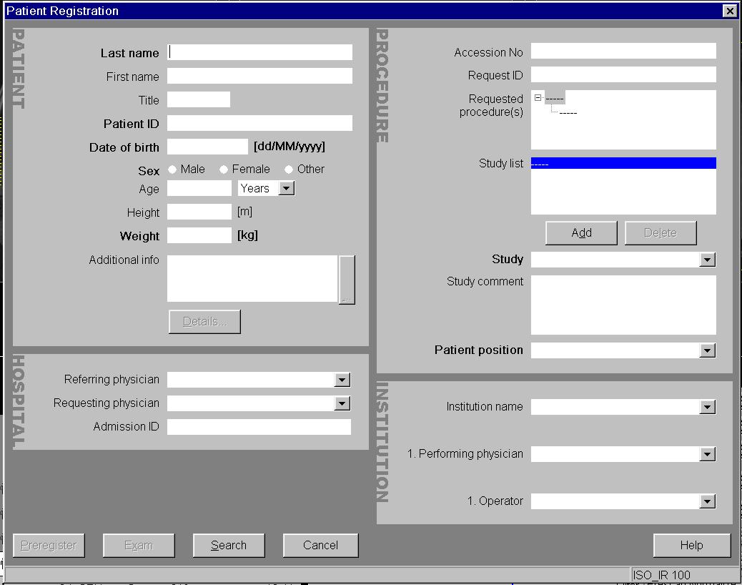
MRI Scanner and Equipment
Scanning Session
Registering the details
of the participant:
18

Slide 19
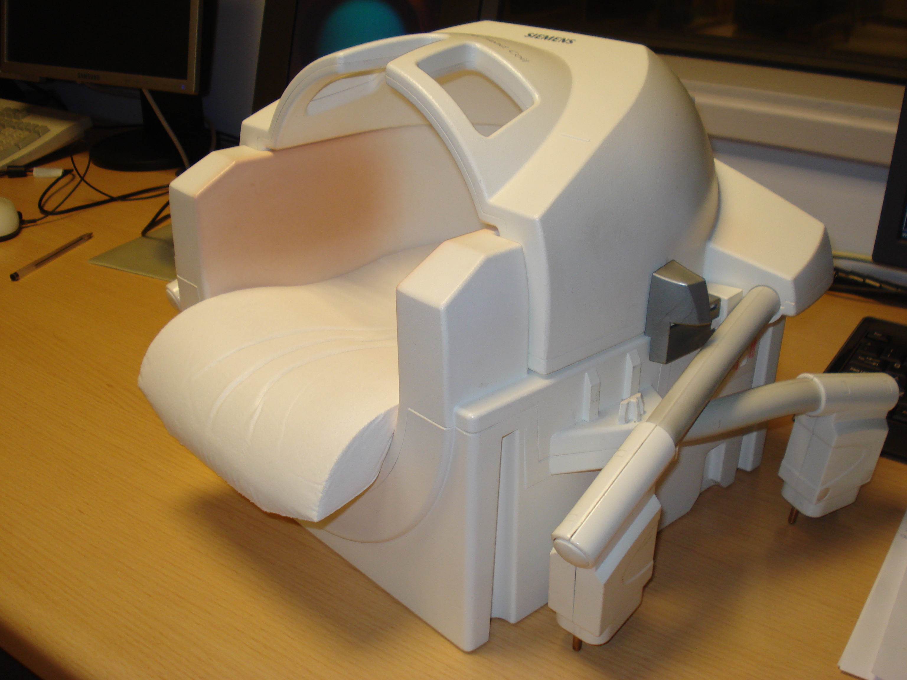
MRI Scanner and Equipment
Head coils
32 Channel head array coil
19

Slide 20
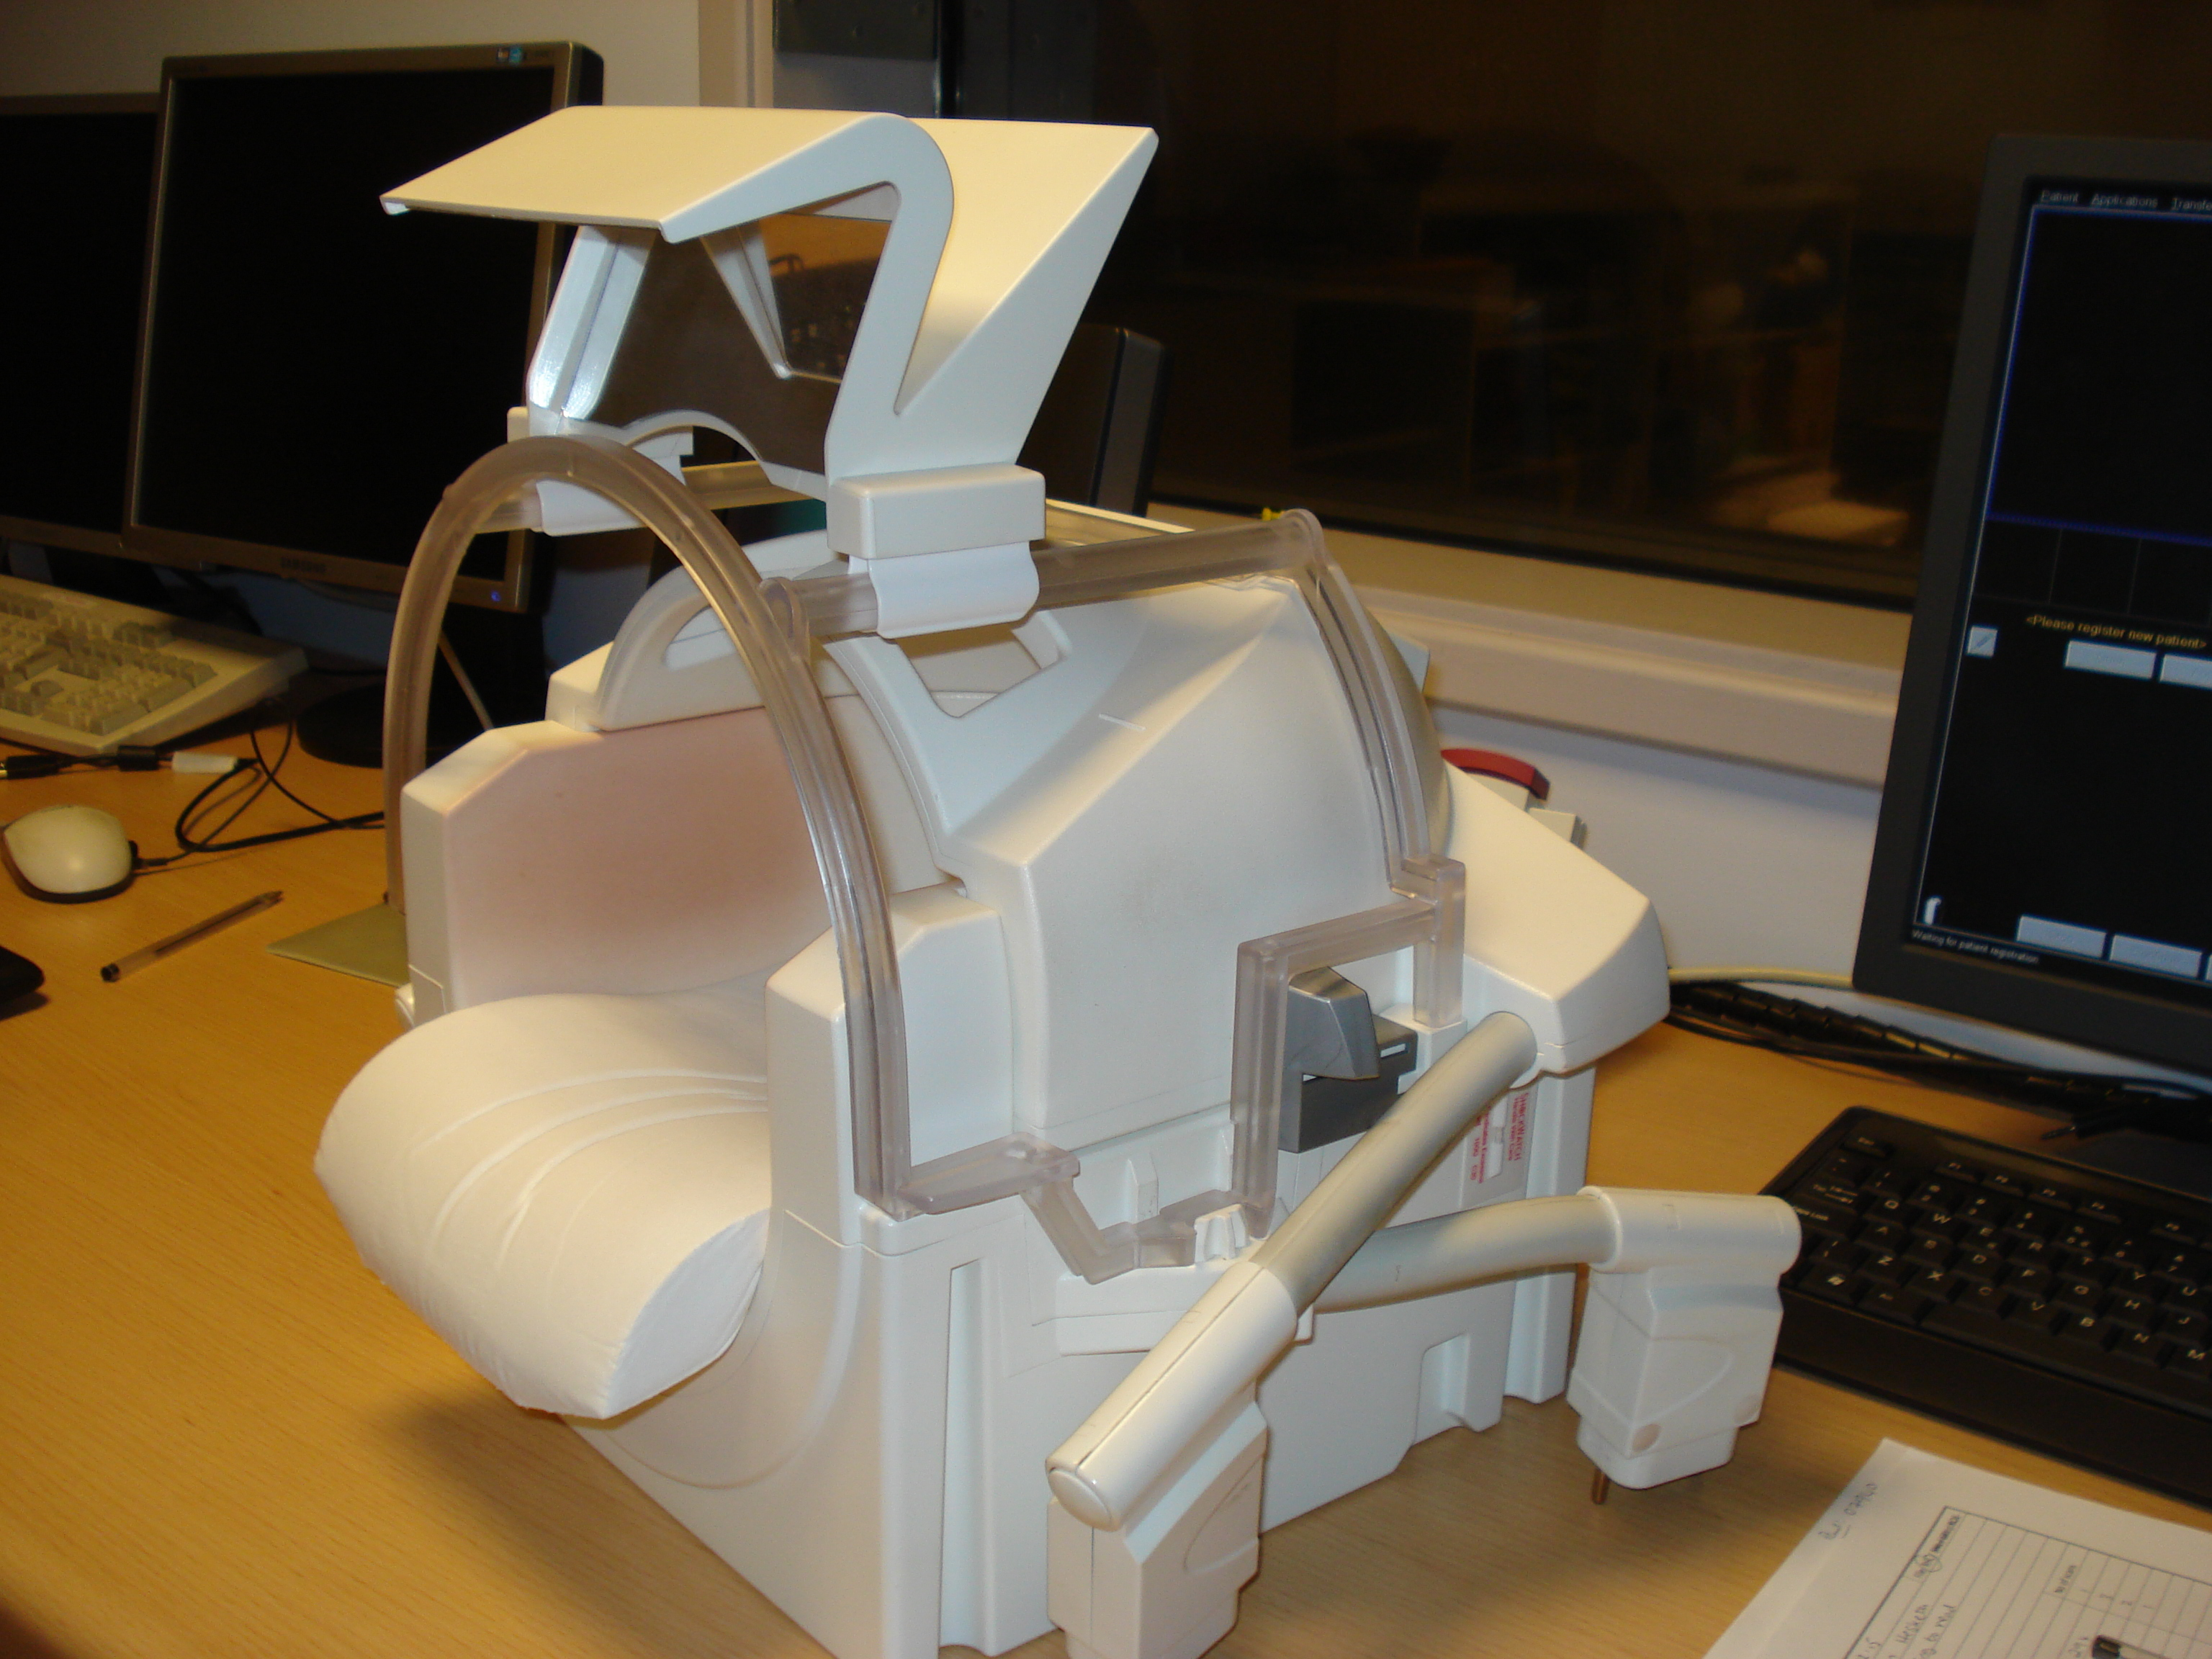
MRI Scanner and Equipment
Head coils
32 Channel head array coil
With the mirror mounted
20

Slide 21
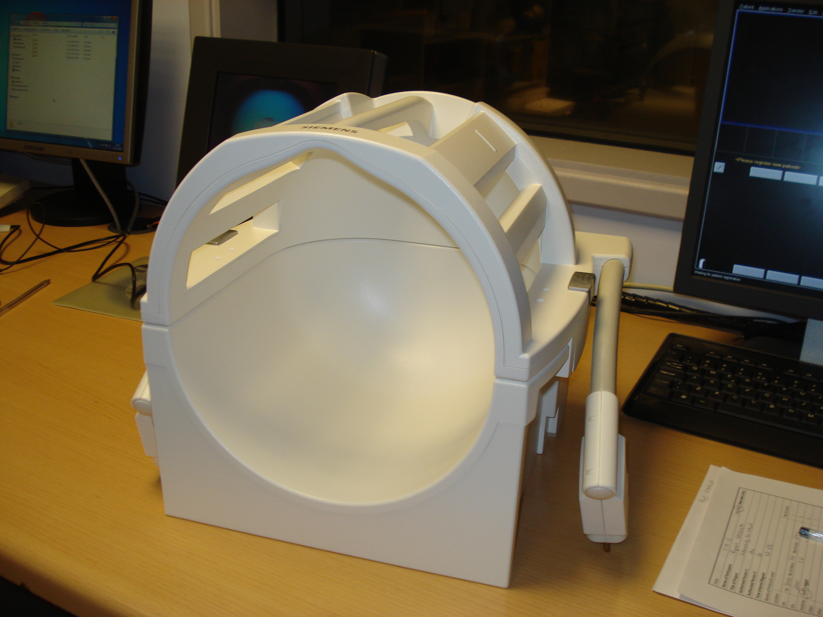
MRI Scanner and Equipment
Head coils
16 Channel head array coil
21

Slide 22
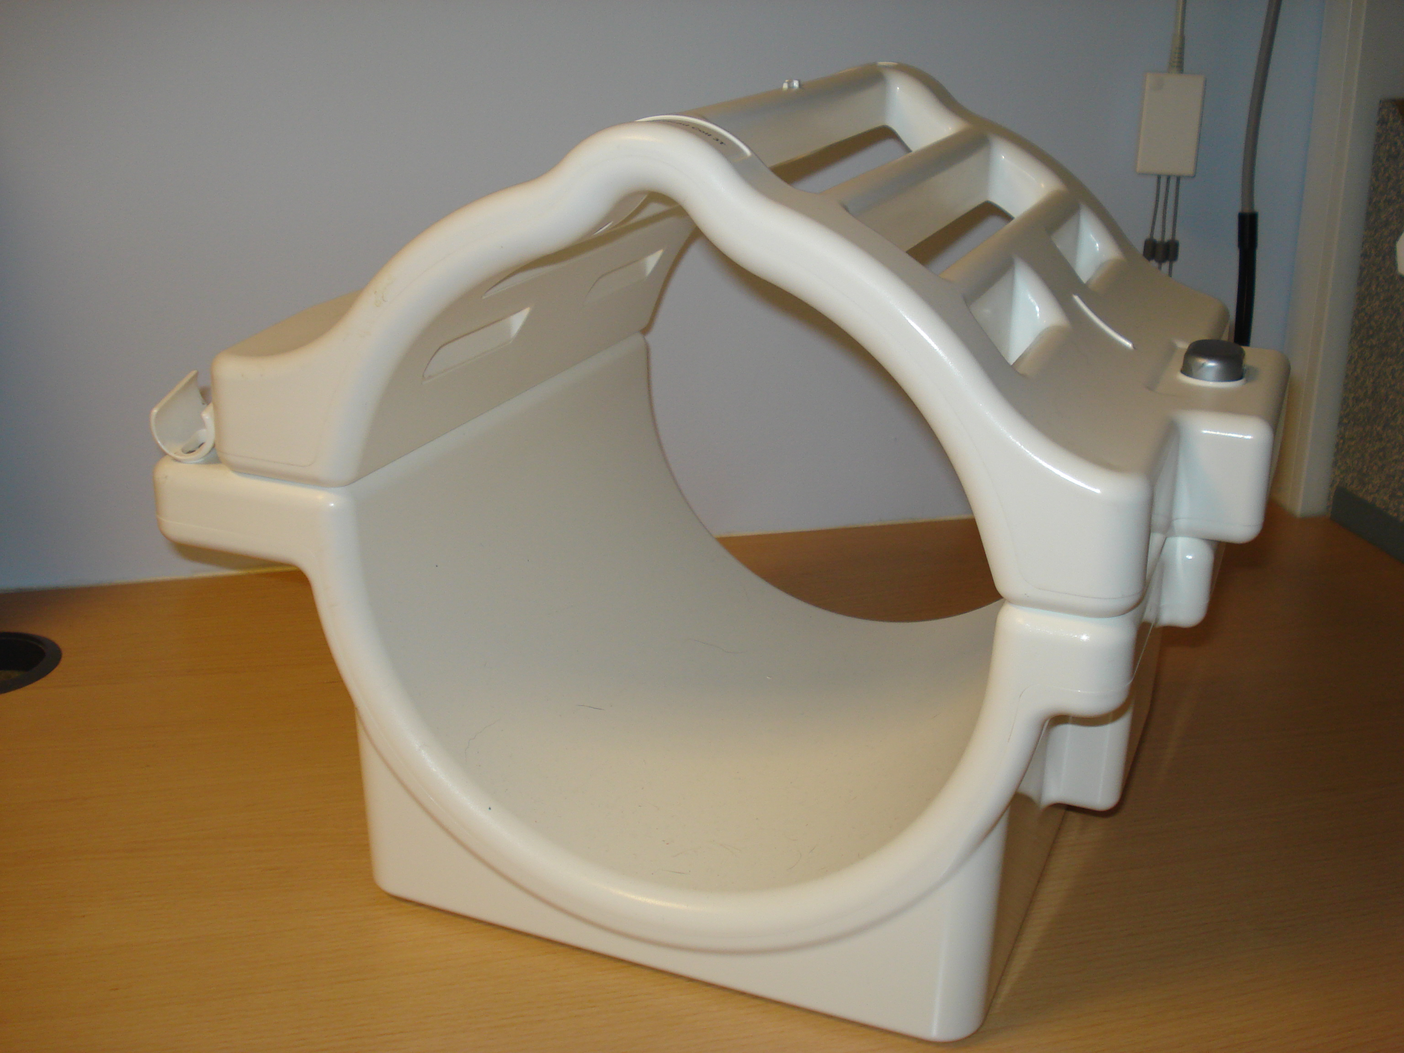
MRI Scanner and Equipment
Head coils
Birdcage coil
22

Slide 23
MRI Scanner and Equipment
Peripheral Equipment
Specially adapted mouse, Left click delivered at the start of each TR for EPIs
Button boxes (CRS – 8 Keys – colour coded, NATA – 10 keys)
Corrective lenses
Headphones (Sensimetrics)
Microphone – OptoAcoustics – FO MRI - III
Eye tracking camera (SR Research, Nordic system)
Bio-Pack modules
TDCS
23

Slide 24
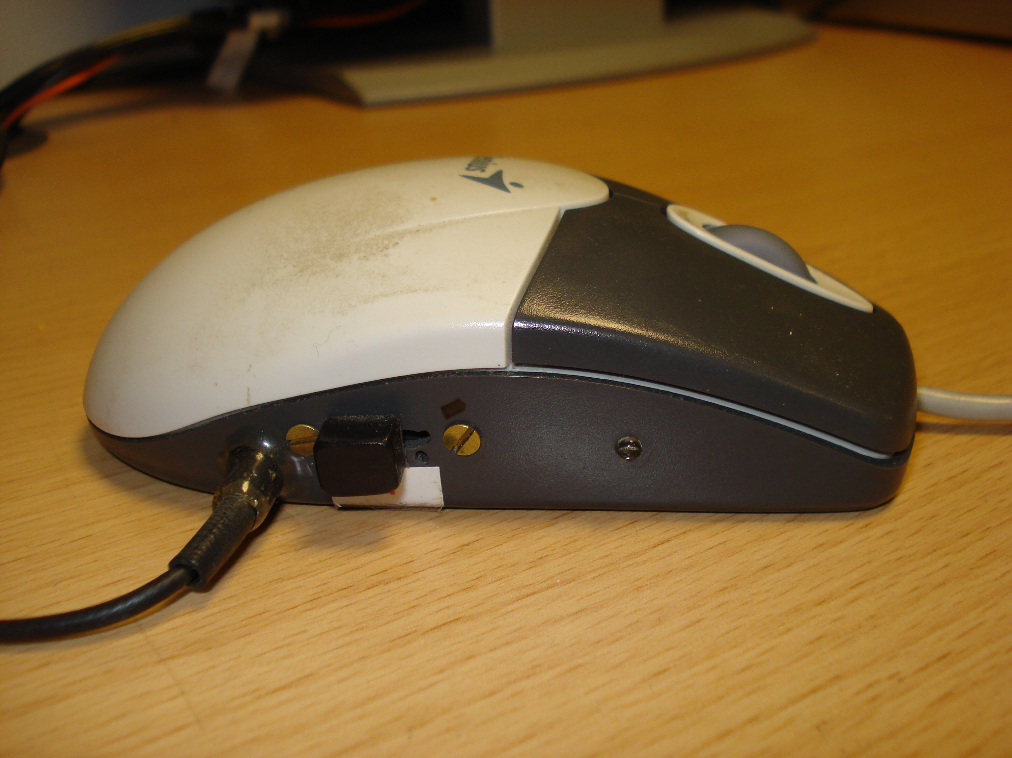
MRI Scanner and Equipment
Peripheral Equipment – Optical mouse
Program your stimulus to start with a left mouse click
to synchronise it with the scanner
24

Slide 25
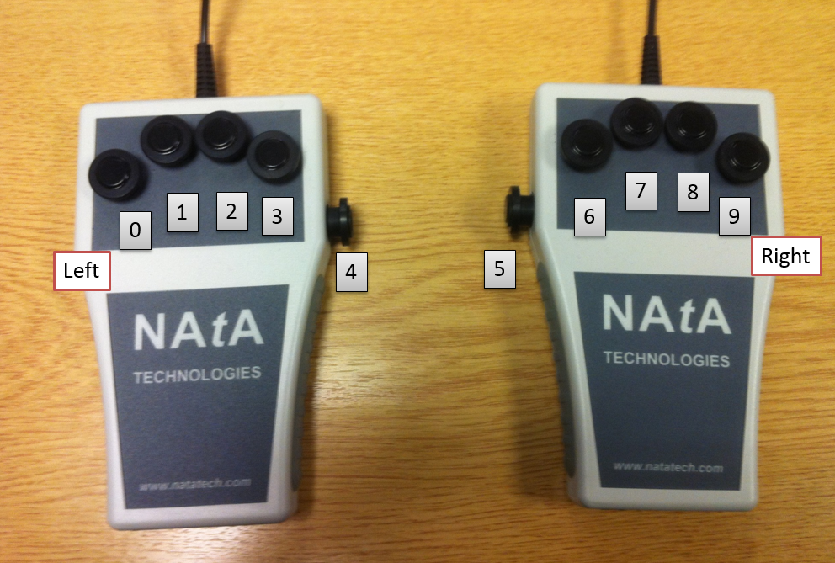
MRI Scanner and Equipment
Peripheral Equipment – Button box - NATA
25

Slide 26
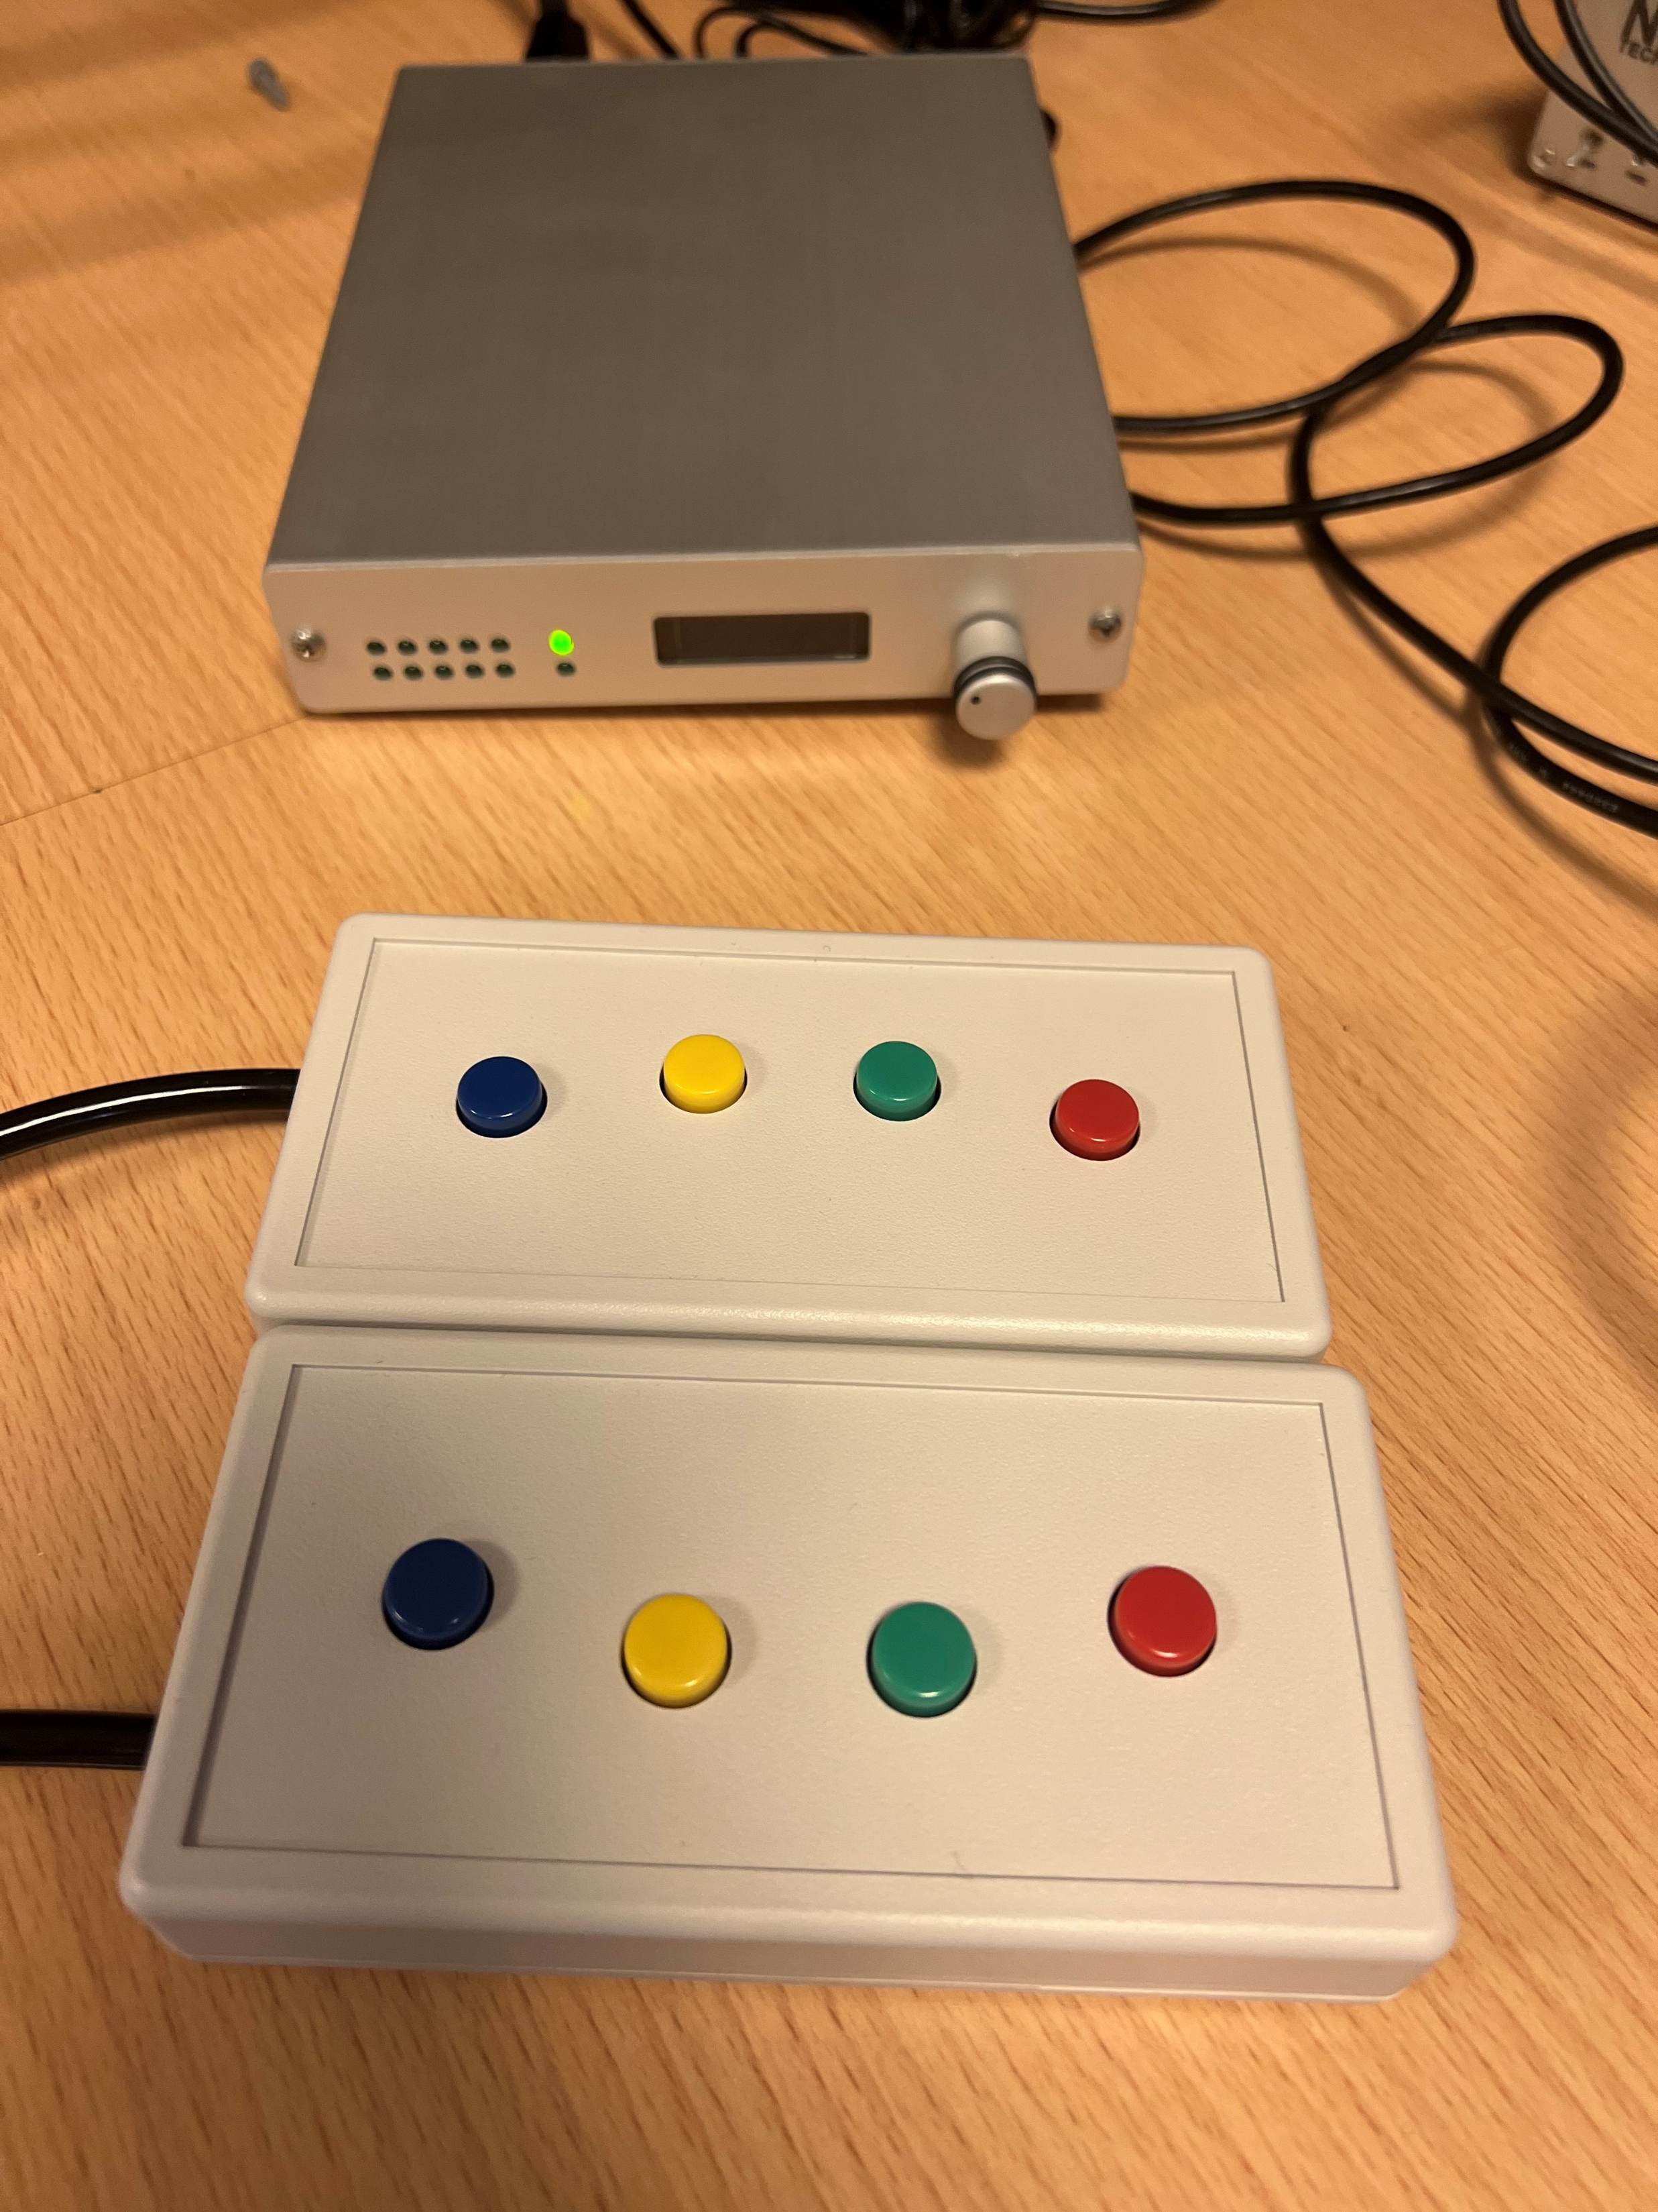
MRI Scanner and Equipment
Peripheral Equipment – Button box - CRS
26

Slide 27
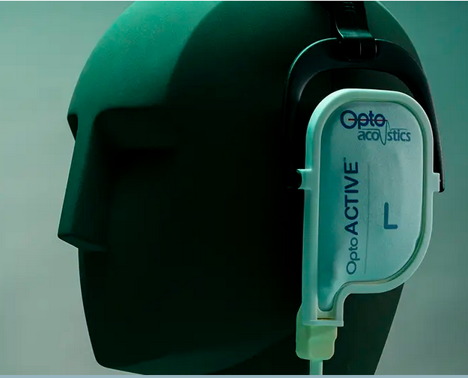
MRI Scanner and Equipment
MRI Scanner and Equipment
Peripheral Equipment – Headphones
Opto-Acoustics headphones
Active noise cancelling
Thin pads
20 dB attenuation

Slide 28
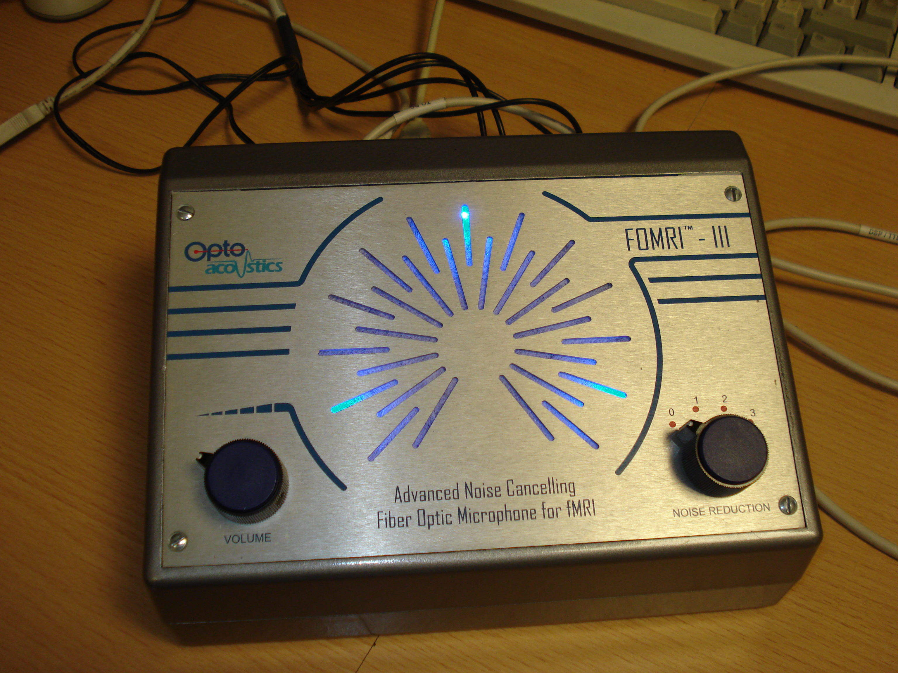
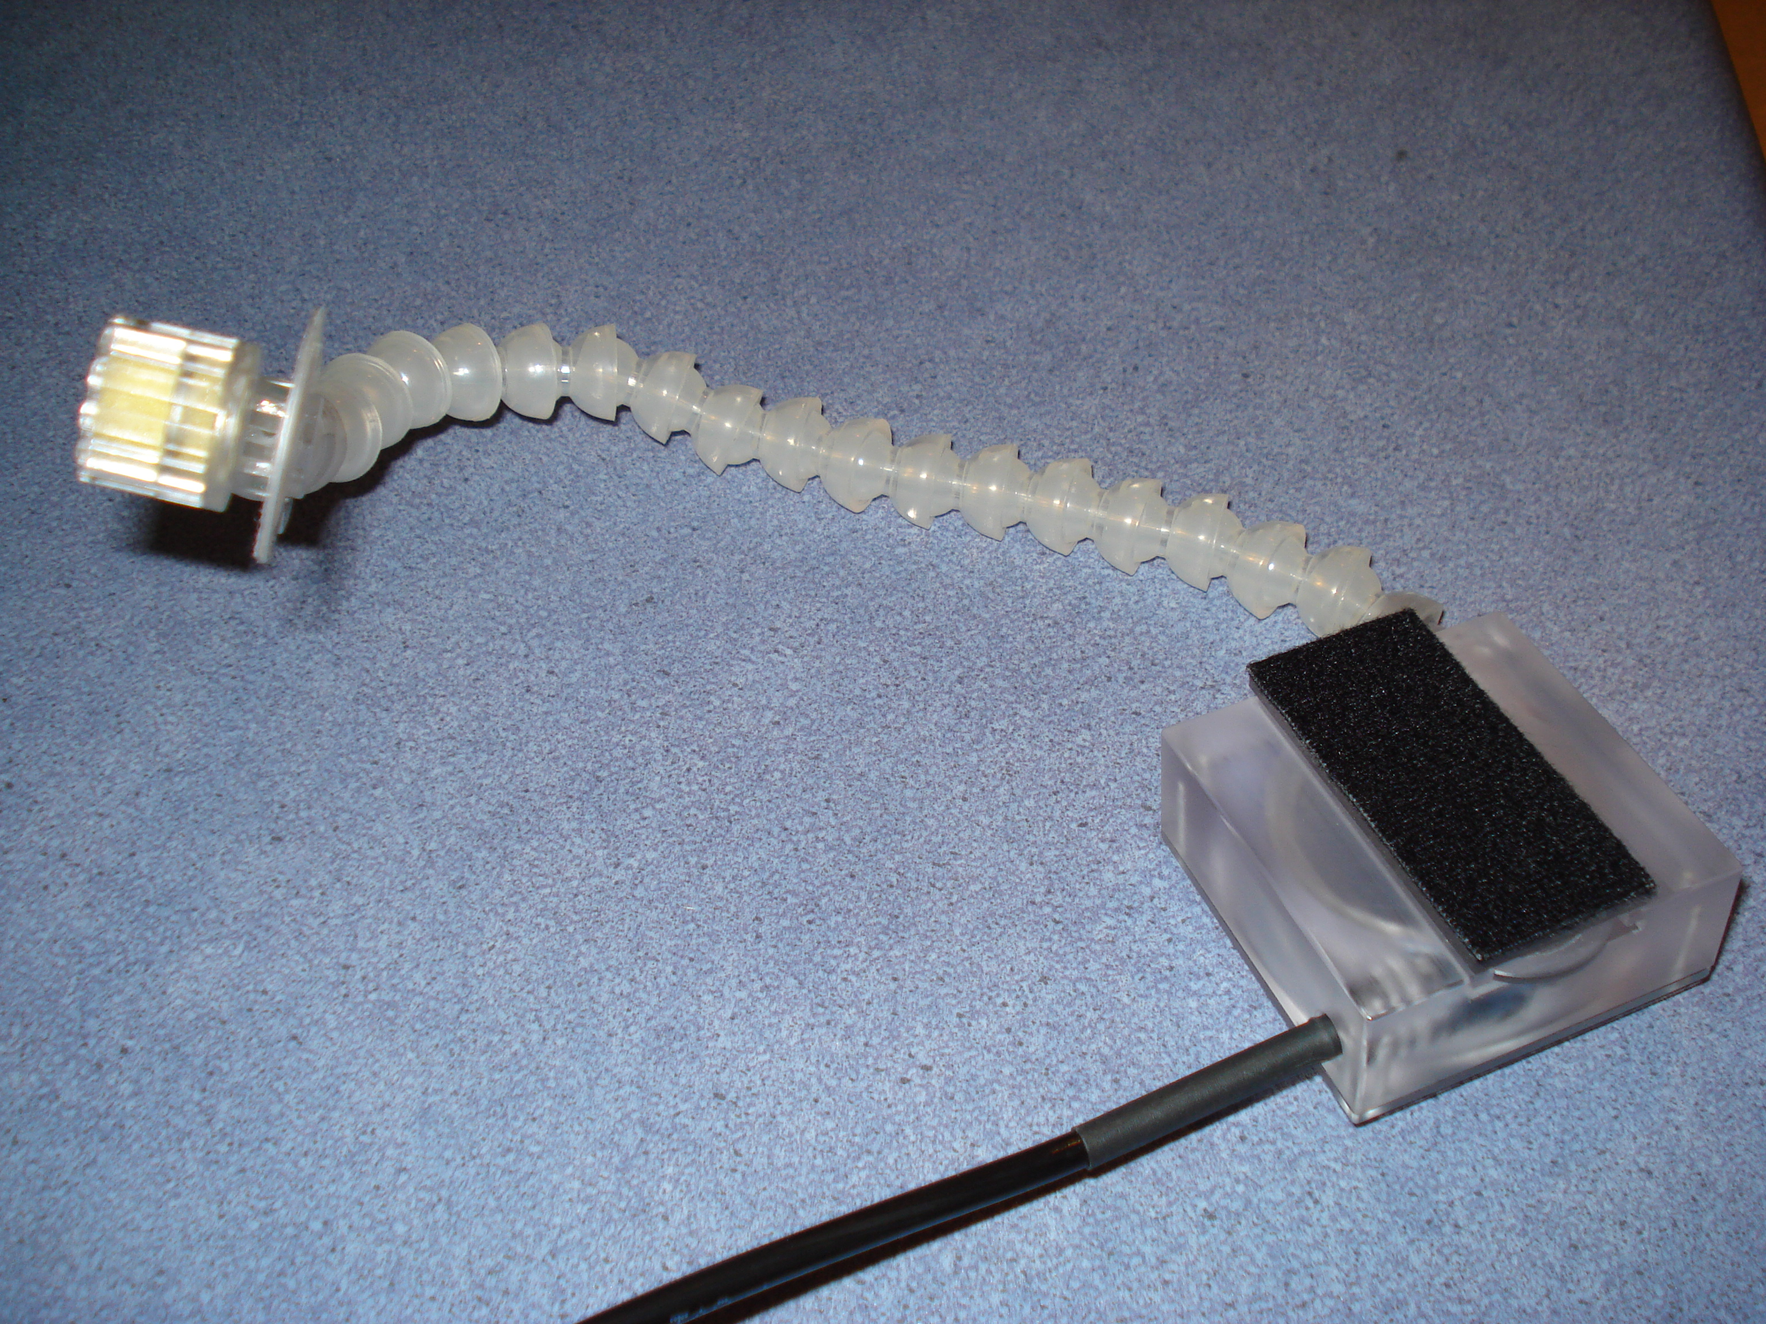
MRI Scanner and Equipment
Peripheral Equipment – Microphone
28

Slide 29
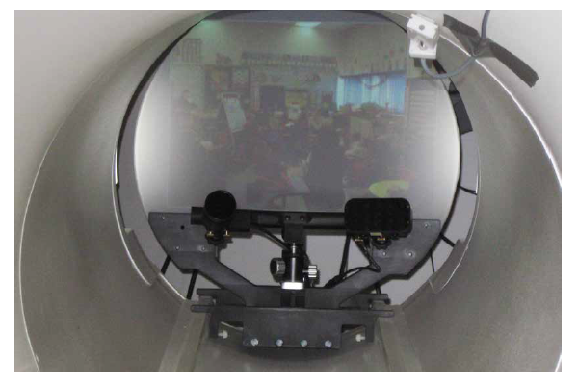
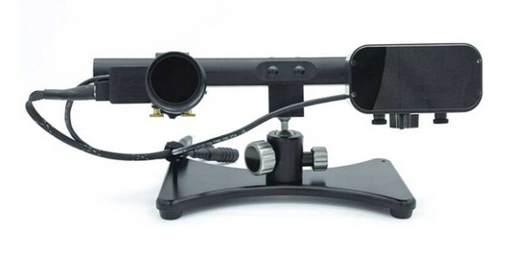
MRI Scanner and Equipment
Peripheral Equipment – Eye Tracking
SR Research – Eye Link system
29

Slide 30
MRI Scanner and Equipment
Peripheral Equipment – BioPack & TDCS
Physiological measurements:
Grip force sensors
ECG / EMG
Nonin Pulseoxymeter
TDCS - neuroConn
30

Slide 31
MRI Sequences
Anatomical Scans:
3D – MPRage ~ 5 minutes
3D – Mdeft – long scan ~13 minutes
2D - T1, T2, GRE, FLAIR, STIR
31

Slide 32
MRI Sequences
Functional Scans:
EPI ASL Multiband
fMRI:
Standard (2 s, 3 mm iso)
High resolution (>1.5 mm in-plane)
Faster (>1 s)
Larger FOV (205 mm)
Multi-Band (>~0.5 s, >1.5mm in-plane)
32

Slide 33
MRI Sequences
Whole-brain Multiband fMRI
Faster acquisition: higher power, more precise sampling of the noise
Higher resolution: lower PVE, smaller susceptibility effect, MVPA
33

Slide 34
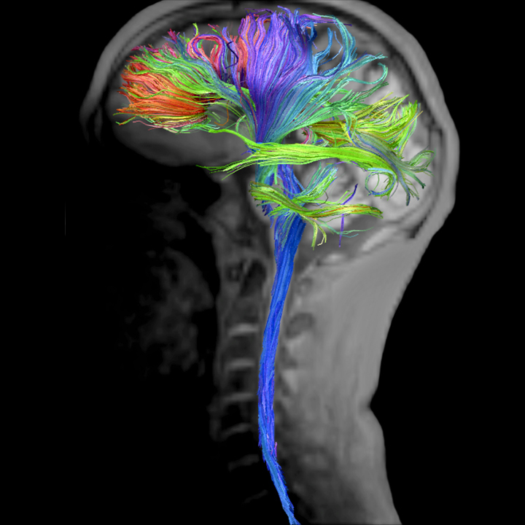
MRI Sequences
Other Scans:
DTI – Diffusion Tensor Imaging
Field maps - same geometry as fMRI (FOV, resolution, angle)
34

Slide 35
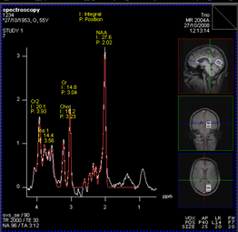
MRI Sequences
Other Scans:
MRS - Spectroscopy - Siemens sequence
MRS – GABA – Jamie Near's special sequence
35

Slide 36
MRI Data
Data comes out in DICOM format. ( *.IMA)
In the Siemens host PC for up to 2 weeks.
Transferred to the MRI server on the same day.
Example file name:
19950621ABCD.MR.RH_Andy.0001.0001.2023.07.31.13.38.
36.656250.72689748.IMA
Participant ID, Modality, Protocol used, Series No, Image No, Date and time of export, System generated ID.
36

Slide 37
Becoming an AP
MRI Safety Test: Written test [Reading list: MRI Local Rules, MHRA Guidance and Risk assessments].
Watch the safety video
Attend a safety lecture / watch the lecture video
First aid course - Emergency First Aid at Work.
Training in moving an unconscious participant from the scanner.
Basic fire training – given part of departmental induction
37

Slide 38
Booking Scanner slots
RH days are Tuesdays and Thursdays
Online calendar system for booking
Bookings are made according to local booking policy – in CUBIC Wiki.
Minimum 15-minute slots
Out of hours and weekends - possible
Pilot testing and equipment testing will not be charged
38

Slide 39
Setup a Study

Slide 40
Setup a study
Apply for grants or Research Initiative Fund (PhD students and new research staff get scan credits)
Need Ethics approval (not required for pilots within lab)
Please fill out the necessary Project proposal form available in the CUBIC Wiki (link)
Work in Progress (WIP) presentation in the users group meeting
Robin approves the total time on the scanner
Ari allocates scan slots
40

Slide 41
Pilot Study

Slide 42
Pilot study
Several hours of free scan time for piloting
Please send literature studies, conference papers etc. or share ideas, replication experiments about a potential study or pilot scans with Ayan (Ayan.Sengupta@rhul.ac.uk ) ASAP.
Ayan helps in designing the fMRI study or getting your stimulation ready for the scanner (if required).
Ari / Ayan will setup and pilot scanning sequences depending on the requirements
42

Slide 43
Data Analysis

Slide 44
Data Analysis
For students Ayan can help in learning to code experiments
Ayan runs PGR workshop sessions:
Introduction to fMRI and basic fMRI analysis - 8th Nov 2023
fMRI analysis in FSL and parallel processing Part 1 - 17th Jan 2024
fMRI analysis in FSL and parallel processing Part 2 - 24th Jan 2024
General data analysis pipelines / set up pipelines on the cluster etc. if required.
Writing publications and methods
Get in touch with Ayan : Ayan.Sengupta@rhul.ac.uk
44

